Slide 1
Identification, Application and Regulatory Qualification of New Translational Kidney Biomarkers for Improved Safety Assessment in Drug Development
Frank D. Sistare
Merck and Co., Inc.
November 19, 2015

Slide 2
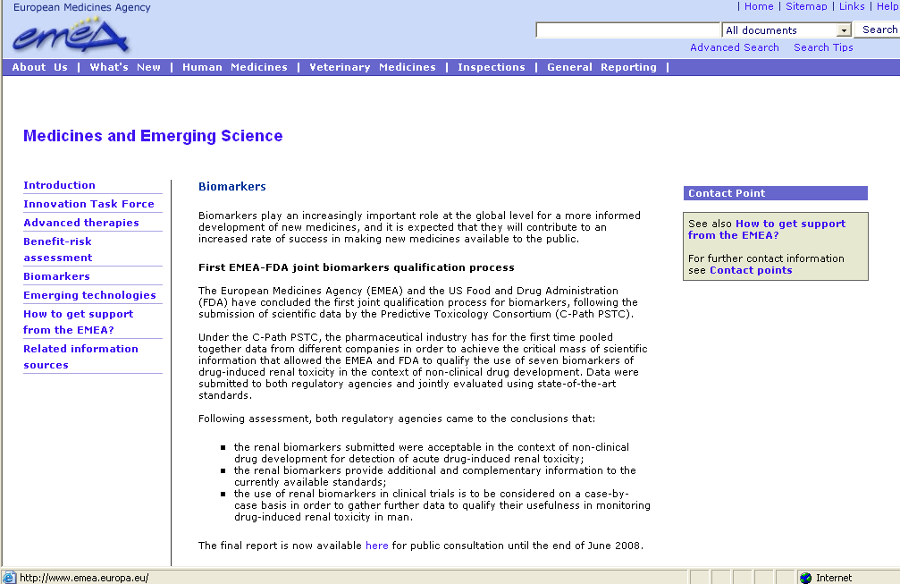
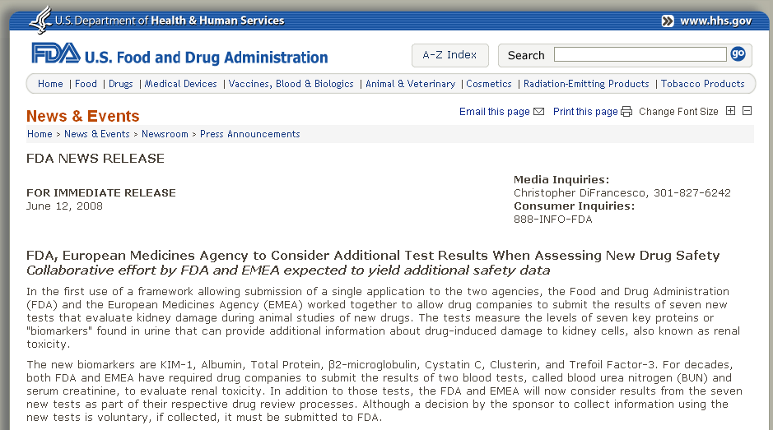
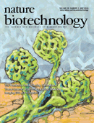
EMA & FDA - 2008 CPath PSTC Receives Favorable Qualification Decisions
Following assessment, both regulatory agencies came to the conclusions that:
the renal biomarkers submitted were acceptable in the context of non-clinical drug development for detection of acute drug-induced renal toxicity;
the renal biomarkers provide additional and complementary information to the currently available standards;
the use of renal biomarkers in clinical trials is to be considered on a case-by-case basis in order to gather further data to qualify their usefulness in monitoring drug-induced renal toxicity in man.
Nature Biotech. May 2010; 10 manuscripts.
Notes:
For historical perspective for other consortia
2

Slide 3
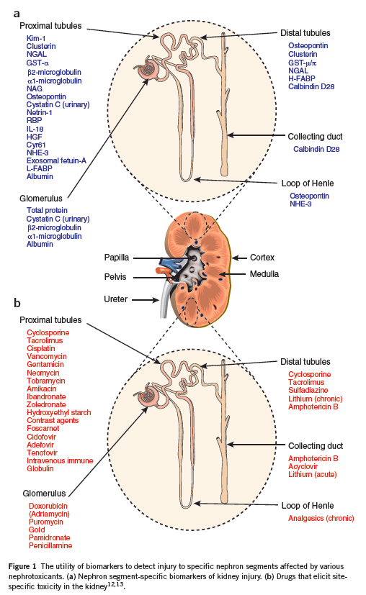
The Hypothesis: New translational kidney safety biomarkers will: 1) report injuries to different segments of the nephron, 2) respond earlier and be more sensitive than BUN and sCr, 3) report on dysfunction, AND damage, AND histopathologic injury response processes (e.g., degeneration, regeneration, dilitation, etc.) 4) inform patient prognosis, 5) enable clinical drug development.
TFF3
*
pp 436 - 440
*Ten manuscripts in this issue on the submission of these biomarker data

Slide 4
Qualification is the evidentiary process of linking a biomarker with biological processes and clinical end points
Qualification is also that agreement that the evidence gathered is sufficient for a specific “context of use”
“EVIDENTIARY STANDARDS” THAT WERE ADOPTED:
Availability of sufficiently validated analytical assay
Biological Understanding:
Understanding relevance to toxicity
Understanding of mechanism of response
Link of biomarker response to observed pathology
Improved Performance Relative to Conventional Biomarkers:
Consistent response across mechanistically different compounds, and response similar across sex, strain, and species
Presence of dose response and temporal relationship to the magnitude of response and injury severity
Specificity of response to toxicity – understanding the response to toxicities in other tissues, or to pharmacologic effects without toxicity in the target organ

Slide 5
Urinary Kidney Biomarkers are more Sensitive than BUN and sCr in a 2-wk NPAA Rat Toxicity Study
NPAA 350, 700, 1200 mg/kg/day; SD4, 8, 15
150
100
50
8
Fold Change
6
4
2
0
-2
sCr
BUN
CLU
ALB
GST-α
NGAL
Kim-1
Clinical Chemistry
ELISAs
Vlasakova K, et al. Tox Sci. 2014;138:3-20.

Slide 6
Kidney Biomarker Performance in 12 Rat Studies: Kim-1 is superior to Serum Creatinine
Serum Creatinine
Kim-1
1.4
3.6
1.2
3.2
2.8
1.0
2.4
0.8
2.0
Fold Change (log₁₀)
1.6
0.6
1.2
0.4
0.8
0.2
0.4
0.0
0.0
-0.4
-0.2
-0.8
Untreated Control
Treated:
Grade 0
Grade 1
Grade 2
Grade 3
Grade 4
Grade 5
Studies for both markers in order as follows:
bacitracin, carbapenem A, cisplatin, cyclosporin, D-serine, gentamicin, HCB, NPAA, propyleneimine, doxorubicin, puromycin, Thy1.1
Vlasakova K, et al. Tox Sci. 2014;138:3-20.

Slide 7
Kim-1 Data Set Across 10 Rat Specificity Studies
Fold Change
TMPD LPS NE EE Merck B Merck A AAM MIN BB APAP
(TMPD, LPS, norethindrone, ethynyl estradiol, Merck B, Merck A, allylamine, minoxidil, bromobenzene, acetaminophen)
Vlasakova K, et al. Tox Sci. 2014;138:3-20.

Slide 8
Summary of Biomarker Performance in 9 Sensitivity and 10 Specificity Studies in Rats
 | Sensitivity and Specificity Studies – Exclusion Model
Biomarker | AUC | Sens* | Fold Cut Off
Kim-1 | 0.96 | 94 | 2.4
Clusterin | 0.93 | 80 | 3.7
Albumin | 0.92 | 73 | 5.2
Osteopontin | 0.86 | 52 | 7.2
Osteoactivin | 0.90 | 66 | 4.5
NGAL | 0.76 | 10 | 20
Cystatin C | 0.80 | 37 | 5.9
NAG | 0.81 | 47 | 2.5
RBP4 | 0.79 | 61 | 3.5
B2M | 0.71 | 24 | 11
Total Protein | 0.74 | 50 | 2.0
GST-α | 0.58 | 44 | 2.2
BUN | 0.77 | 46 | 1.7
sCr | 0.72 | 54 | 1.1
*Sensitivity values at 95% specificity.
1.0
0.9
0.8
0.7
0.6
Sensitivity
0.5
0.4
0.3
0.2
0.1
0.0
0.0
0.1
0.2
0.3
0.4
0.5
0.6
0.7
0.8
0.9
1.0
1 - Specificity
Kim-1
Clusterin
Albumin
Osteopontin
NAG
RBP4
B2M
Total Protein
Osteoactivin
NGAL
Cystatin C
GST-α
BUN
sCr
Vlasakova K, et al. Tox Sci. 2014;138:3-20.

Slide 9
14 Day Tobramycin Biomarker Study in 6 Rhesus Monkeys +/- Biopsies
Group | Animal ID | Histopathology @ Day 15 by Full Section | Serum Creatinine |  |  |  |  | Urine KIM-1 |  |  |  |  | Urine CLUSTERIN |  |  |  |  | Biopsy Gene Expression |  |  |  |  | Gene Expression @ Day 15 in Tissue Section
 |  |  | (mg/dL) |  |  |  |  | (pg/mg Cr) |  |  |  |  | (ng/mg Cr) |  |  |  |  | (Fold Change) |  |  |  |  | (Fold Change)
 |  |  | Sample Day |  |  |  |  | Sample Day |  |  |  |  | Sample day |  |  |  |  | Sample Day
 |  |  | -4 | 4 | 8 | 11 | 15 | -4 | 4 | 8 | 11 | 15 | -4 | 4 | 8 | 11 | 15 | -4 | 4 | 8 | 11 | 15
Control w/o Biopsy | 1a | None | 0.8 | 0.8 | 0.7 |  | 0.7 | BLQ | BLQ | BLQ | BLQ | BLQ | 68 | BLQ | 232 | 165 | 135 |  |  |  |  | 1.0 | 2.0 | Kim1
 |  |  |  |  |  |  |  |  |  |  |  |  |  |  |  |  |  |  |  |  |  | 1.0 | 1.1 | Clu
 |  |  |  |  |  |  |  |  |  |  |  |  |  |  |  |  |  |  |  |  |  | 1.0 | 1.4 | Opn
 | 1b | None | 0.7 | 0.8 | 0.6 | 0.7 | 0.7 | BLQ | BLQ | BLQ | BLQ | BLQ | BLQ | 846 | 751 | 225 | 168 |  |  |  |  | 0.7 | 0.2 | Kim1
 |  |  |  |  |  |  |  |  |  |  |  |  |  |  |  |  |  |  |  |  |  | 1.3 | 1.5 | Clu
 |  |  |  |  |  |  |  |  |  |  |  |  |  |  |  |  |  |  |  |  |  | 1.7 | 2.2 | Opn
Control w Biopsies | 2a | Casts; Needle track inflamm. & hemor. | 0.7 |  | 0.8 | 0.8 | 0.8 | 0.8 | BLQ | BLQ | BLQ | BLQ | 575 | 805 | 1477 | 1763 | 647 | 0.6 |  | 0.8 |  | 19.6 | 1.1 | Kim1
 |  |  |  |  |  |  |  |  |  |  |  |  |  |  |  |  |  | 0.8 |  | 1.7 |  | 4.2 | 1.2 | Clu
 |  |  |  |  |  |  |  |  |  |  |  |  |  |  |  |  |  | 0.2 |  | 0.5 |  | 3.5 | 0.6 | Opn
 | 2b | Casts; Needle track inflamm. & hemor. | 0.9 |  | 0.8 | 0.8 | 0.8 | BLQ | BLQ | BLQ | BLQ | BLQ | 231 | BLQ | 124 | 185 | 2021 |  | 0.2 |  | 0.2 | 0.3 | 0.3 | Kim1
 |  |  |  |  |  |  |  |  |  |  |  |  |  |  |  |  |  |  | 1.8 |  | 1.4 | 2.2 | 1.4 | Clu
 |  |  |  |  |  |  |  |  |  |  |  |  |  |  |  |  |  |  | 1.0 |  | 0.7 | 1.6 | 1.7 | Opn
Tobramycin 20 mkd w Biopsies | 3a | Casts; Needle track inflamm. & hemor. PLUS Tubular Dilatation Gr 2 | 0.7 |  | 0.8 | 0.8 | 0.9 | BLQ | BLQ | BLQ | BLQ | BLQ | 200 | 275 | 285 | 956 | 794 | 2.5 |  | 2.4 |  | 90.7 | 14.0 | Kim1
 |  |  |  |  |  |  |  |  |  |  |  |  |  |  |  |  |  | 2.1 |  | 2.5 |  | 4.2 | 3.6 | Clu
 |  |  |  |  |  |  |  |  |  |  |  |  |  |  |  |  |  | 0.7 |  | 2.3 |  | 12.0 | 4.9 | Opn
 | 3b | Casts; Needle track inflamm. & hemor. PLUS Tubular Dilatation Gr 2 AND Tubular Degener. Gr 1 | 0.7 | 0.9 | 0.7 | 0.8 | 0.9 | BLQ | BLQ | 87 | 311 | 594 | 151 | 312 | 1925 | 1921 | 6555 |  | 1.2 |  | 59.0 | 234.6 | 66.2 | Kim1
 |  |  |  |  |  |  |  |  |  |  |  |  |  |  |  |  |  |  | 3.0 |  | 3.1 | 5.6 | 5.9 | Clu
 |  |  |  |  |  |  |  |  |  |  |  |  |  |  |  |  |  |  | 0.8 |  | 2.8 | 24.8 | 18.7 | Opn
(1) No evidence of tobramycin-induced microscopic histopathology was noted in ANY of the biopsy samples (including day 15)
(2) The biopsy procedure itself appears to effect urine biomarkers and tissue gene expression, and could cloud interpretation.
(3) Urine biomarkers would appear to be the superior translational research tool for interpretation of kidney injury response

Slide 10
2 Years/34 Animal Studies
7+ Years/2 Clinical Studies
Kim-1
clusterin
TFF3
albumin
Partnering proposal
to FNIH BC for
Kidney BM
clinical qualification
FDA & EMA
Approve COU,
SAP (Assay
approval pending)
Total protein
B2 microglobulin
Cystatin C
First submission
FDA, July
Project plan
approved
Launch of
2 clinical studies
2006
2007
2008
2009
2010
2011
2012
2013
2014
2015
2016
2017
FDA & EMA support qualification claims for 7 biomarkers
for nonclinical & limited clinical use – 34 studies
Funding, contracts, protocols, assays, legal agreements, etc
“Limited COU”
FDA & EMA
Submission
Expected
clinical data
“FINAL Qualification”
Submission
Formation of
PSTC
Summary of hypothetical but reasonable examples of drug development scenarios that support the patient health, scientific and business case for qualifying new translational safety biomarkers. [Sistare, Frank D and DeGeorge Joseph J, Biomarkers Med 2011 5(4) 497-514]
Phase of Development | Example | Summary Description | Estimated Benefit from Deploying New Safety Biomarker
Pre-Candidate Selection Phase Applications | #1 Renal Injury De-Risked at Cmpd Selection | NHP exhibits renal tox with lead that is thought to be human relevant. 3 candidates selected for minimal study using renal biomarker longitudinal measurements. | Safest of 3 candidates selected for development to minimize drug development delay.
Preclinical GLP Animal Toxicology Studies and / or Clinical Trials | #5 Rat-only Kidney Pathology First Seen in Chronic Study | New translational kidney biomarkers demonstrate monitorability of kidney toxicity. Shorter rat studies and chronic monkey studies are negative. Clinical studies show no changes in kidney biomarkers. | Ambiguities about human safety concerns are eliminated. $31M+ in clinical development preserved. Delays in development avoided.
 | #6 Dog-only Kidney Pathology Seen in First GLP Study | New translational kidney biomarkers demonstrate monitorability of kidney toxicity seen only in Dog w “medium” margin. Clinical studies conducted show no changes in kidney biomarkers. | Ambiguities about human safety concerns are eliminated. $10M+ in preclinical development preserved. Delays in development avoided.
10

Slide 11
FNIH BC/ CPath PSTC Kidney Translational Safety Biomarker Clinical Qualification Project
Objective
To provide the data needed to advance the clinical qualification and broader acceptance of new translational biomarkers for monitoring kidney safety that would support early clinical drug development
Learn and Confirm Strategy
Retrospective analysis:
Use an existing set of freezer samples from malignant mesothelioma patients treated with cisplatin, some meeting established criteria for AKI (e.g., 50% rise of sCr) + set of control samples from NHV
Select biomarkers; establish assays; set thresholds for each biomarker; formulate adjudication guidelines for the second confirmatory prospective phase
Prospective analysis: 2 clinical trials

Slide 12
Prospective Trials Design
Cisplatin & Aminoglycoside selected because they are SOC agents, known to cause kidney tubule injury, w documented incidence rates in sCr rises
100 patients (50 Ctrls),
blood and urine
100 patients (50 Ctrls),
blood and urine
Aminoglycosides
in patients with
cystic fibrosis
Cisplatin
in patients with
certain cancers
First site
USC
PI: Paul Beringer
First site
U. of Minnesota
PI: Joanne Billings
First site
MD Anderson
PI: Ala Abudayyeh
First site
Dana Farber
PI: Sus Waiker
Third site
U. of Utah
PI: David Young
Fourth site – in contracting
Denver National Jewish Health
PI: Mimi Saavedra
Nov 1, 2015 Status:
78% recruitment
Nov 1, 2015 Status:
34% recruitment

Slide 13
Learning Phase Data Summary: 8 Selected Urinary Biomarkers Show Improved Sensitivity Over sCr to Identify Patients Exposed to Cisplatin
 | Mesothelioma Patients: Number/N (%) >T_{SS}* |  | Normal Healthy Volunteers: % >T_{SS}
Biomarker | Patients With Medically Relevant Increases in sCr | Patients Without Medically Relevant Increases in sCr | Normal eGFR No Cisplatin (N = 80)
Clusterin | 19/20 (95.0%) | 22/30 (73.3%) | 1.3%
Osteopontin | 20/20 (100.0%) | 30/31 (96.8%) | 5.1%
Microalbumin | 20/20 (100.0%) | 30/30 (100.0%) | 2.5%
Total Protein | 20/20 (100.0%) | 30/30 (100.0%) | 3.8%
NAG | 20/20 (100.0%) | 27/30 (90.0%) | 0%
Kim-1 | 20/20 (100.0%) | 30/30 (100.0%) | 1.3%
Cystatin-C | 19/20 (95%) | 22/30 (73.3%) | 5.1%
NGAL | 19/20 (95%) | 24/30 (80.0%) | 4.1%
*T_{SS} = statistically significant threshold.

Slide 14
Increases in Sensitivity while Maintaining Specificity
Cohort | N | X (%) with ≥ 1 BmX > T_{SS} | X (%) with ≥ 2 BmX > T_{SS} | X (%) with ≥ 3 BmX > T_{SS} | X (%) with ≥ 4 BmX > T_{SS} | X (%) with ≥ 5 BmX > T_{SS} | X (%) with ≥ 6 BmX > T_{SS} | X (%) with ≥ 7 BmX > T_{SS} | X (%) with ≥ 8 BmX > T_{SS}
Jasper NHV Cohort | 76 | 16 (21%) | 2 (3%) | 0 (0%) | 0 (0%) | 0 (0%) | 0 (0%) | 0 (0%) | 0 (0%)
Meso Patients With Medically Relevant Increases in sCr | 20 | 20 (100%) | 20 (100%) | 20 (100%) | 20 (100%) | 20 (100%) | 20 (100%) | 19 (95%) | 17 (85%)
Meso Patients Without Medically Relevant Increases in sCr | 30 | 30 (100%) | 30 (100%) | 30 (100%) | 30 (100%) | 29 (97%) | 28 (93%) | 23 (77%) | 16 (53%)
Statistical analysis plan (SAP) alignment with FDA/ EMA includes both “human adjudication”, and “automated rules” analyses based confirmations
“Automated rules” analysis SAP includes a statistical step-down approach to fairly assess the comparative value of using fewer than the 8 biomarkers

Slide 15
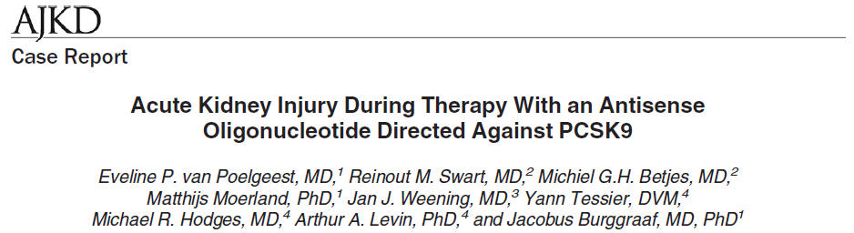
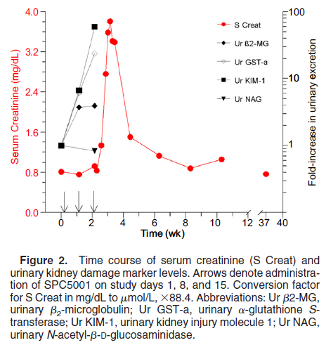
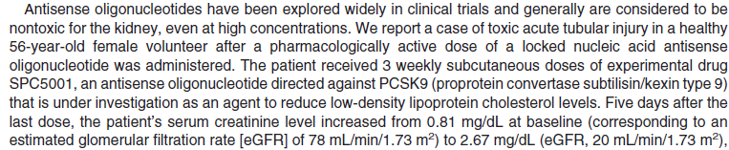
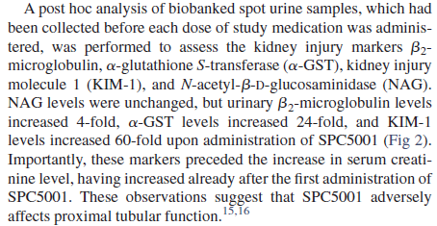

Slide 16
A Progressive Clinical Qualification Framework for Translational Safety Biomarkers
Qualification Path
Letter of Support
Qualification (1)
Qualification (2)
Aspirational CoU
Letter of Support
Data Package
Publications
Limited CoU
Qualification
Exploratory / Learning Phase Data
Publications
Extended CoU
Qualification
Confirmatory / Prospective Studies
Publications
COU
Data
Study Design
Toxicants
Publications
Nonclinical
Clinical

Slide 17
A Limited Context of Use Proposal
Intent
To encourage the use of 6 novel biomarkers in Phase 1 NHV SAD or MAD clinical trials as a calculated composite group mean (used in conjunction with sCr, BUN, Total Urinary Protein, and Urinary Albumin) to estimate the probability of deviation of a dose cohort from normal variability
Overview of the Approach
Limited Context of Use for a Composite Measure (CM) is NOT intended for individual patient safety monitoring. The goal of the Prospective Studies will be to qualify biomarkers for individual patient safety monitoring.
Use of the CM leverages the learning phase clinical data and allows Sponsors to gain experience and define an acceptable risk tolerance based on the benefit/risk associated with the indication under investigation
A proposal has been submitted to FDA and EMA in July 2015 for consideration in parallel to the Full Clinical Qualification Process

Slide 18
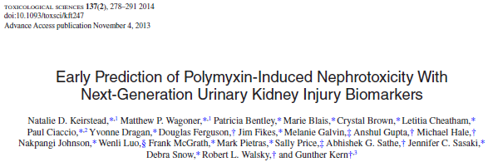
Lead Identification
Lead Optimization
PreClinical Development
Clinical
Translation
Post
Marketing
Pre Lead ID
Filing
Single Candidate
Selection
Summary of hypothetical but reasonable examples of drug development scenarios that support the patient health, scientific and business case for qualifying new translational safety biomarkers.
[Sistare, Frank D and DeGeorge Joseph J, Biomarkers Med 2011 5(4) 497-514]
Phase of Development | Example | Summary Description | Estimated Benefit from Deploying New Safety Biomarker
Pre-Candidate Selection Phase Applications | #1 Renal Injury De-Risked at Cmpd Selection | NHP exhibits renal tox with lead that is thought to be human relevant. 3 candidates selected for minimal study using renal biomarker longitudinal measurements. | Safest of 3 candidates selected for development to minimize drug development delay.
Preclinical GLP Animal Toxicology Studies and / or Clinical Trials | #5 Rat-only Kidney Pathology First Seen in Chronic Study | New translational kidney biomarkers demonstrate monitorability of kidney toxicity. Shorter rat studies and chronic monkey studies are negative. Clinical studies show no changes in kidney biomarkers. | Ambiguities about human safety concerns are eliminated. $31M+ in clinical development preserved. Delays in development avoided.
 | #6 Dog-only Kidney Pathology Seen in First GLP Study | New translational kidney biomarkers demonstrate monitorability of kidney toxicity seen only in Dog w “medium” margin. Clinical studies conducted show no changes in kidney biomarkers. | Ambiguities about human safety concerns are eliminated. $10M+ in preclinical development preserved. Delays in development avoided.
18

Slide 19
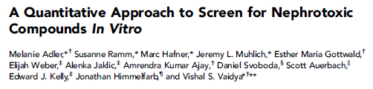
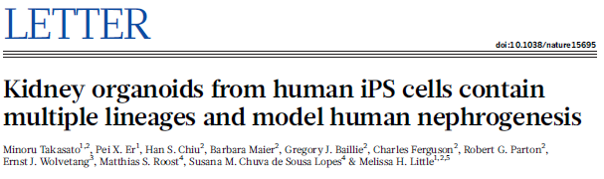
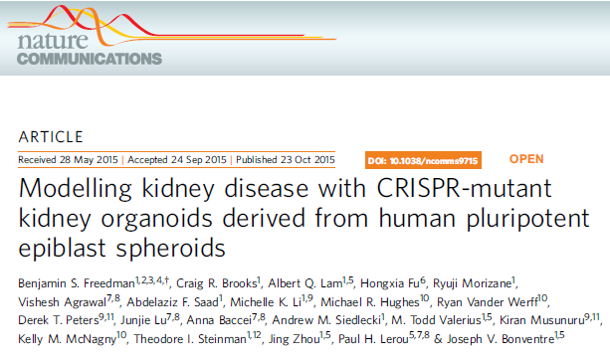
What about “Translation” to Lead Op and even Lead ID Applications?

Slide 20
Merck Animal Study Data
FNIH BC/CPath PSTC Kidney Safety Biomarker Project Team
Katerina Vlasakova
Zoltan Erdos
Wendy Bailey
Kathy McNulty
Valerie Chapeau-Campredon
Nathalie Mokrzycki
Nagaraja Muniappa
Sean Troth
David Gerhold
Dan Holder
Yi-Zhong Eddie Gu
Warren Glaab
Takayuki Tsuchiya
Robert Peiffer
Larry Handt
Amgen Wayne Tsuji
AstraZeneca Scott Adler
Brigham & Women’s Hospital/ Dana Farber Sushrut Waikar, Robert Haddad
Denver National Jewish Hospital
Mimi Saavedra
C-Path Amanda Baker, Martin Cisneroz, Nicholas King, Gary Lundstrom, John-Michael Sauer, Elizabeth Walker
FDA Melanie Blank, Aliza Thompson
FNIH Jessica Ratay, Maria Vassileva
Johnson & Johnson James Lenhard, Robin Mogg
Lilly James Voelker
NIH/NIDDK Paul Kimmel
Merck Irene Nunes, Elizabeth Ommen, Frank Sistare, Michael Tanen, Michael Topper
PSTC Stefan Sultana (Novartis) Jaromir Mikl (Boehringer-Ingelheim) Steven Piccoli (BMS)
Pfizer Gary Friedman
University of Minnesota Joanne Billings
University of Alabama at Birmingham Gary Cutter, David Warnock
University of California, San Diego Ravindra Mehta
University of Southern California Paul Beringer
University of Texas MD Anderson Cancer Center Ala Abudayyeh, Bonnie Glisson
University of Utah David Young
Mesothelioma Learning Phase Data
Joseph Bonventre
Sushrut Waikar

